Slide 1


Web Server Log Analysis using Big Data REVIEW – 1
Team Members
Roll No Name
2320030310 M. Manaswi
2320030302 S. Kusumitha
2320030069 P. Phani Tejaswi
Department of Computer Science and Engineering
KONERU LAKSHMAIAH EDUCATION FOUNDATION

Slide 2
Outline
Abstract
Introduction
Proposed Method
Objectives
Literature Survey
Implementation
Architecture
Module Design

Slide 3
Abstract
Web servers generate a large amount of log data that records every user request made to a website. These logs contain important information such as the IP address, timestamp, request type, status code, and response size. Analyzing this log data helps organizations understand user behavior, monitor website traffic, detect system errors, and identify potential security threats. However, traditional log analysis tools face difficulties in processing large-scale datasets efficiently due to limitations in speed and scalability. To address this issue, this project proposes a Web Server Log Analysis system using Apache Spark, a distributed big data processing framework that enables fast data analysis through in-memory computation. The system collects web server log files and processes them using PySpark and Spark SQL to extract meaningful insights such as request frequency, status code distribution, unique visitors, and traffic patterns. The analyzed results are presented through an interactive visualization dashboard, allowing administrators to easily monitor website performance and detect abnormal activities. By utilizing distributed computing and big data analytics, the proposed system improves the efficiency, scalability, and speed of web log analysis.

Slide 4
Introduction
Web servers generate large volumes of log data that record every user request, response status, IP address, and access time. Analyzing this log data helps organizations understand user behavior, detect security threats, and optimize system performance.
Traditional log analysis tools struggle to process large-scale datasets efficiently. To address this problem, Apache Spark, a distributed big data processing framework, can analyze massive log files quickly using in-memory computation.
This project focuses on building a web-based log analytics system that processes server logs and visualizes insights through interactive dashboards.
Applications
Cybersecurity threat detection
Website traffic monitoring
Performance optimization
User behavior analysis

Slide 5
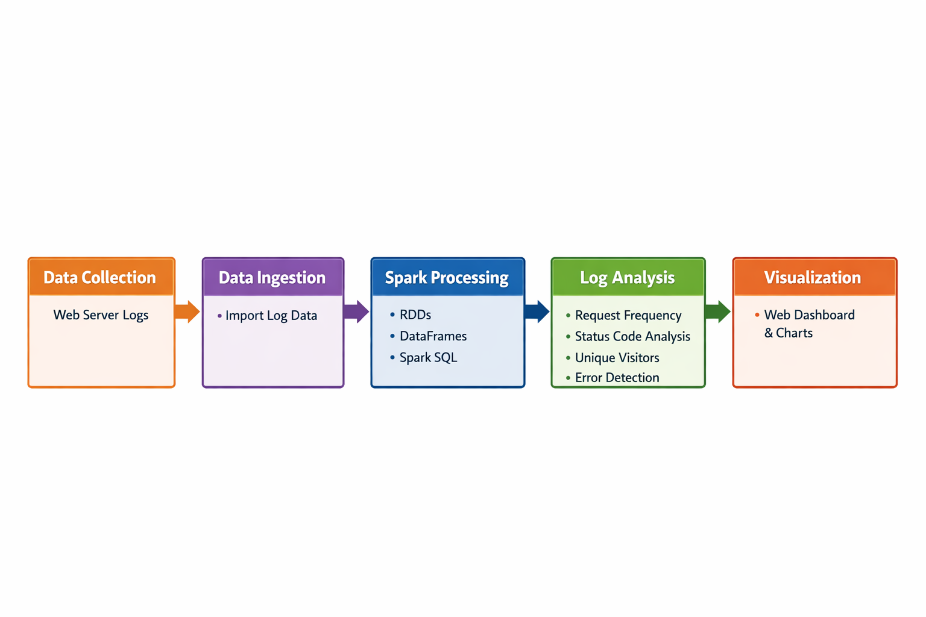
Proposed Method

Slide 6
Objectives
The main objectives of this project are:
To analyze large-scale web server log data using Apache Spark.
To extract meaningful insights such as traffic patterns, error rates, and user behavior.
To visualize log analytics results through an interactive dashboard.
To detect anomalies such as suspicious login attempts or unusual traffic spikes.

Slide 7
Literature Survey
Paper Title | Reference Link | Drawback | Future Work
Large-Scale Web Log Analysis Using Hadoop | https://arxiv.org/abs/1709.03546 | High latency due to disk-based processing and lack of real-time analysis. | Can be extended using in-memory processing and real-time streaming frameworks.
Apache Spark for Big Data Processing | https://arxiv.org/abs/1802.00316 | Requires high memory resources and complex configuration. | Optimization techniques and cloud-based deployment can improve performance.
Web Usage Mining from Server Logs | https://ieeexplore.ieee.org/document/7488251 | Limited to historical data analysis and lacks real-time insights. | Integration with real-time log streams for dynamic behavior analysis.
Big Data Analytics for Log Data | https://www.sciencedirect.com/science/article/pii/S1877050917322094 | Scalability issues when handling extremely high-velocity data. | Adoption of distributed streaming platforms for continuous data ingestion.
Real-Time Log Analysis Using Distributed Systems | https://link.springer.com/article/10.1007/s00521-020-04762-8 | Complex system design and high computational cost. | Simplified architectures and intelligent anomaly detection methods.

Slide 8
Paper Title | Reference Link | Drawback | Future Work
Log Mining for Web Usage Analysis | https://ieeexplore.ieee.org/document/611314 | Limited ability to handle large-scale datasets efficiently. | Use of big data technologies like Spark and Hadoop for scalable analysis.
Big Data Processing Using MapReduce | https://research.google/pubs/pub62/ | Slow processing due to disk-based batch processing model. | Replacement with in-memory computing frameworks such as Apache Spark.
Scalable Log Processing with Apache Spark | https://spark.apache.org/research.html | High resource consumption in distributed clusters. | Development of optimized algorithms and lightweight processing pipelines.
Web Log Mining Using Data Mining Techniques | https://link.springer.com/chapter/10.1007/978-3-319-59888-8_7 | Limited support for real-time analytics and anomaly detection. | Integration with machine learning algorithms for predictive analysis..
Distributed Log Analysis for Web Applications | https://dl.acm.org/doi/10.1145/3183713.3196902 | Difficult system maintenance and complex distributed architecture. | Automated log monitoring systems with intelligent alert mechanisms.

Slide 9
Implementation
Tools and Technologies Used
Apache Spark
Python (PySpark)
React / Web Dashboard
Node.js / Web Server
Apache / Nginx Log Dataset
Recharts / Data visualization libraries
Dataset
The dataset consists of Apache/Nginx web server logs.
Example log entry:
192.168.1.105 - - [01/Jan/2024:10:15:32 +0000] "GET /api/users HTTP/1.1" 200 1542
Log Fields
IP Address
Timestamp
HTTP Request
Status Code
Response Size
These logs are processed in Spark to generate analytics.

Slide 10
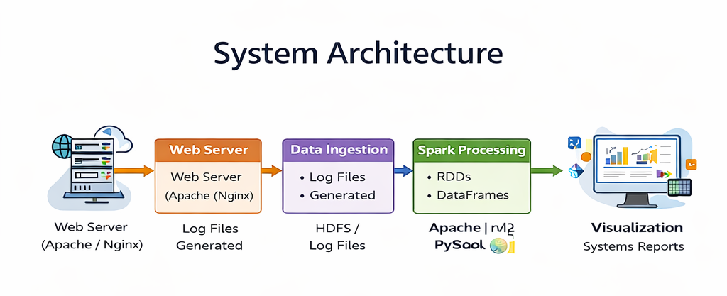

Slide 11
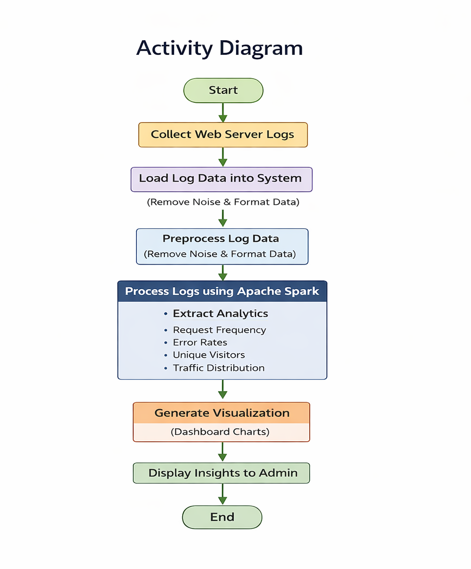

Slide 12
Conclusion
This project demonstrates how Apache Spark can efficiently analyze large-scale web server logs. By using distributed computing and in-memory processing, the system can process millions of log entries quickly.
The developed system provides:
Faster log processing
Real-time insights through dashboards
Detection of anomalies and error patterns
Future Work
Real-time streaming log analysis using Spark Streaming
Integration with security monitoring systems
Machine learning for anomaly detection

Slide 13
THANK YOU

